Slide 1

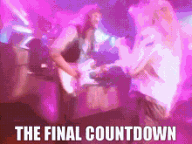

THE FINAL COUNTDOWN
Applied Language Team
Notes:
Levi

Slide 2
Overview
Team
About the Project
Design
Implementation
Roadblocks
Testing
Finished Product
Takeaways
Notes:
Levi

Slide 3
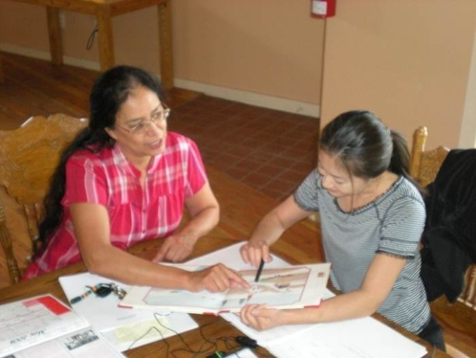
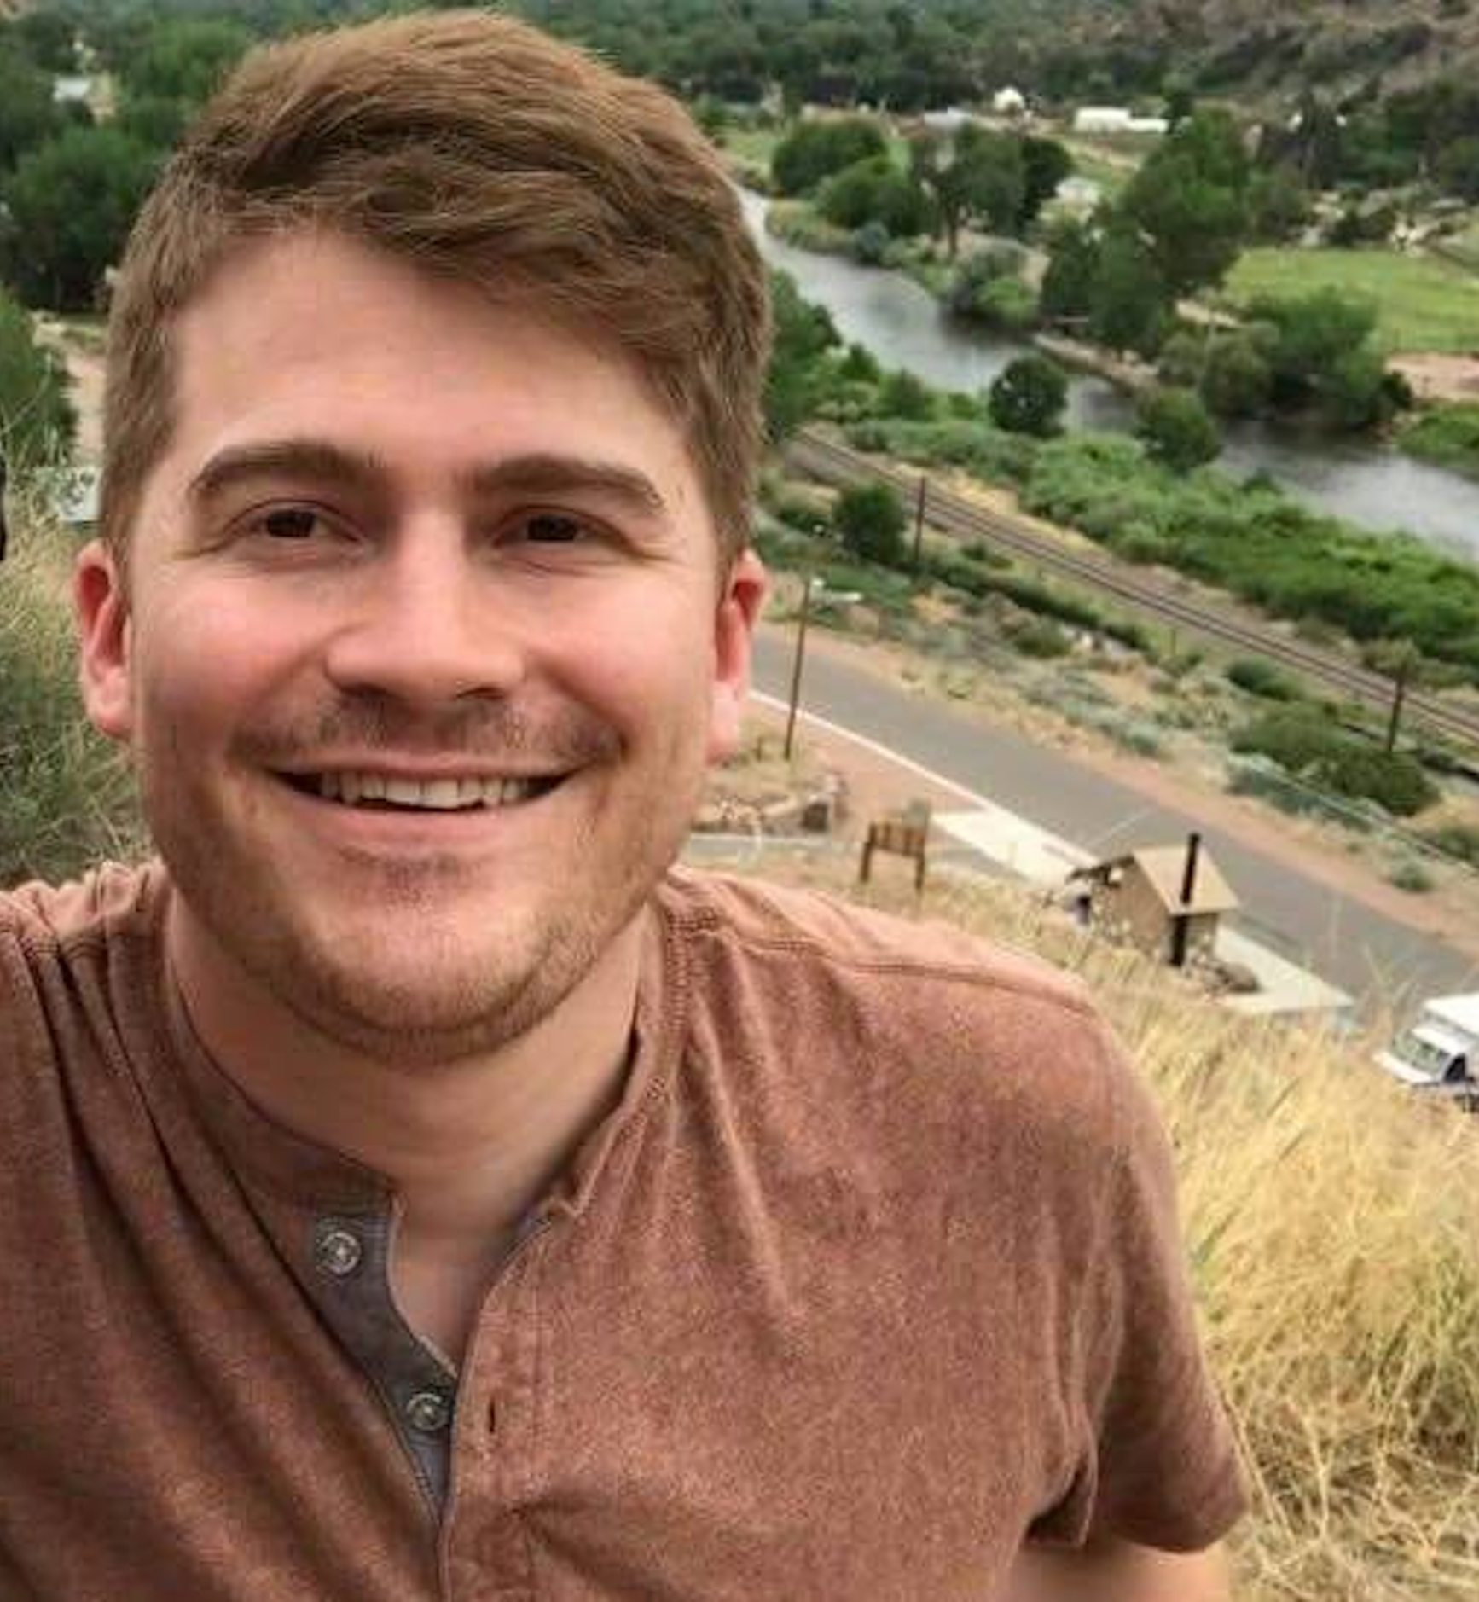
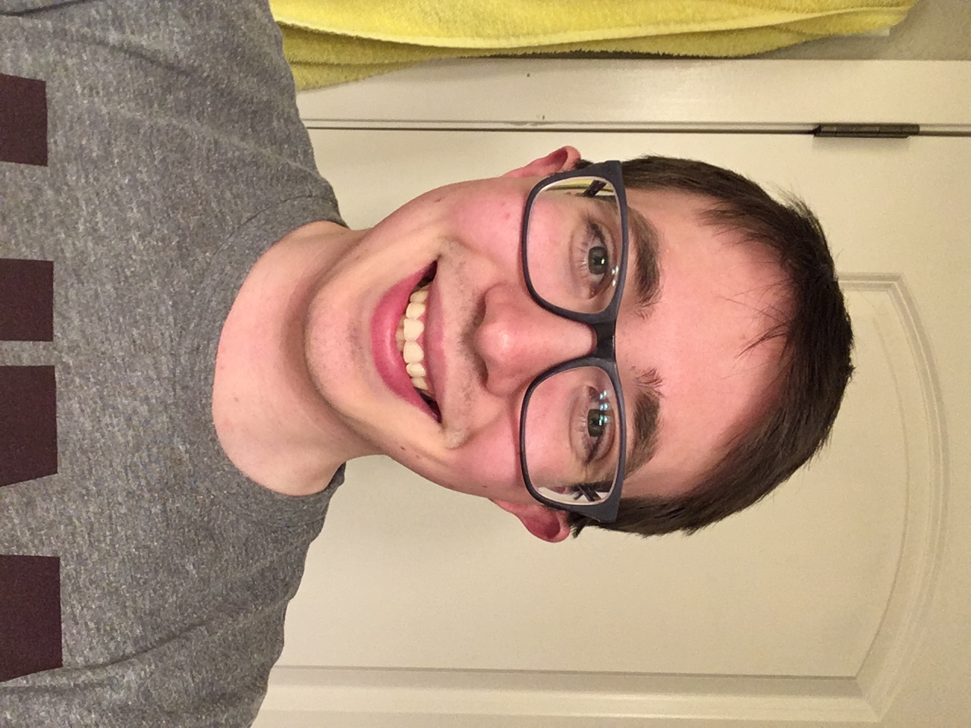

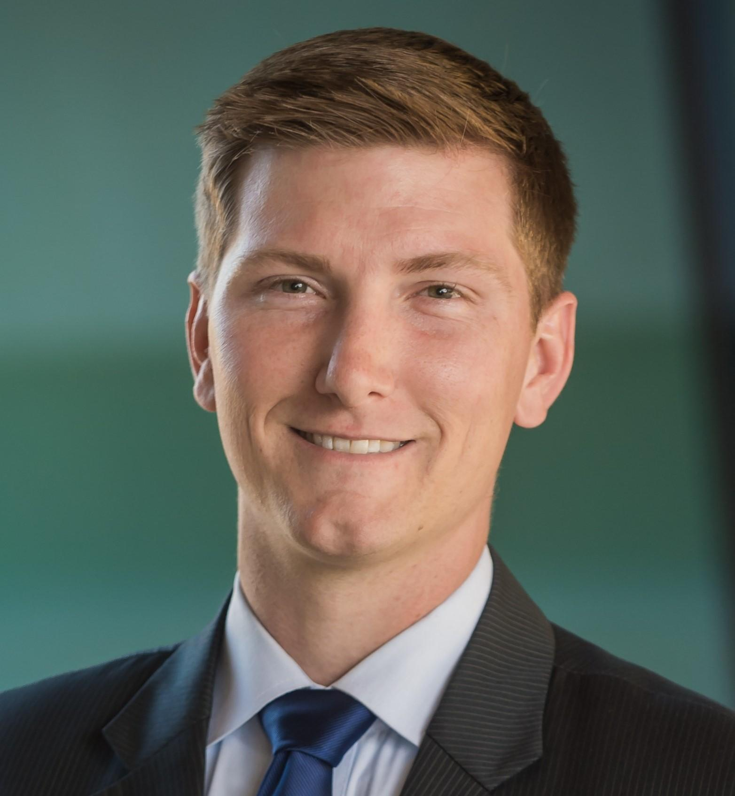
Applied Language Team
Client
Team
David Gereau
Kobe Sagami
Linda Schimming
Levi Terry
Dr. Mizuki Miyashita - Linguistics Researcher
Phonetics and phonology
Second language acquisition
Blackfoot
Notes:
Dr. Mizuki Miyashita is a Professor of Linguistics at the University of Montana. Her specialization is sound pattern analysis in Native American languages. Her current research interest is Blackfoot phonology. Her research in Blackfoot aims to contribute both to linguistics research and language revitalization.

Slide 4
Applied Language Research
Automate Dr. Miyashita’s existing in-person process:
Gather audio recordings from language learners
Send audio to native Blackfoot speakers for pronunciation feedback
Dr. Miyashita had to physically travel and meet with native speakers
View feedback on audio for specific words for data generation
Notes:
Levi

Slide 5
Design
First semester designing the website
Analyze previous team’s work
Requirements gathering
Low-fidelity prototypes
System modeling
Implementation plan
Notes:
Linda

Slide 6
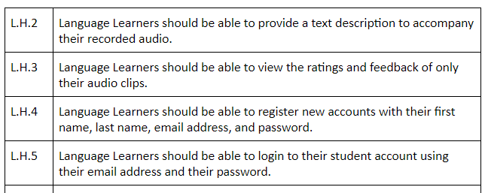
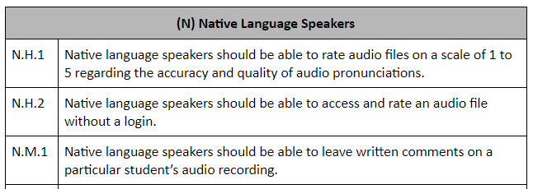
Design
Requirements Specification
Document outlining:
User groups and tasks
When, where, how system is used
Functional and non-functional requirements
Software
Hardware
Database
User
Notes:
Linda

Slide 7
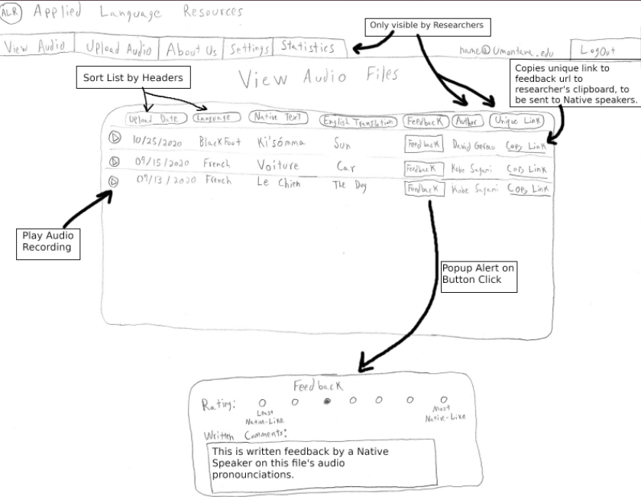
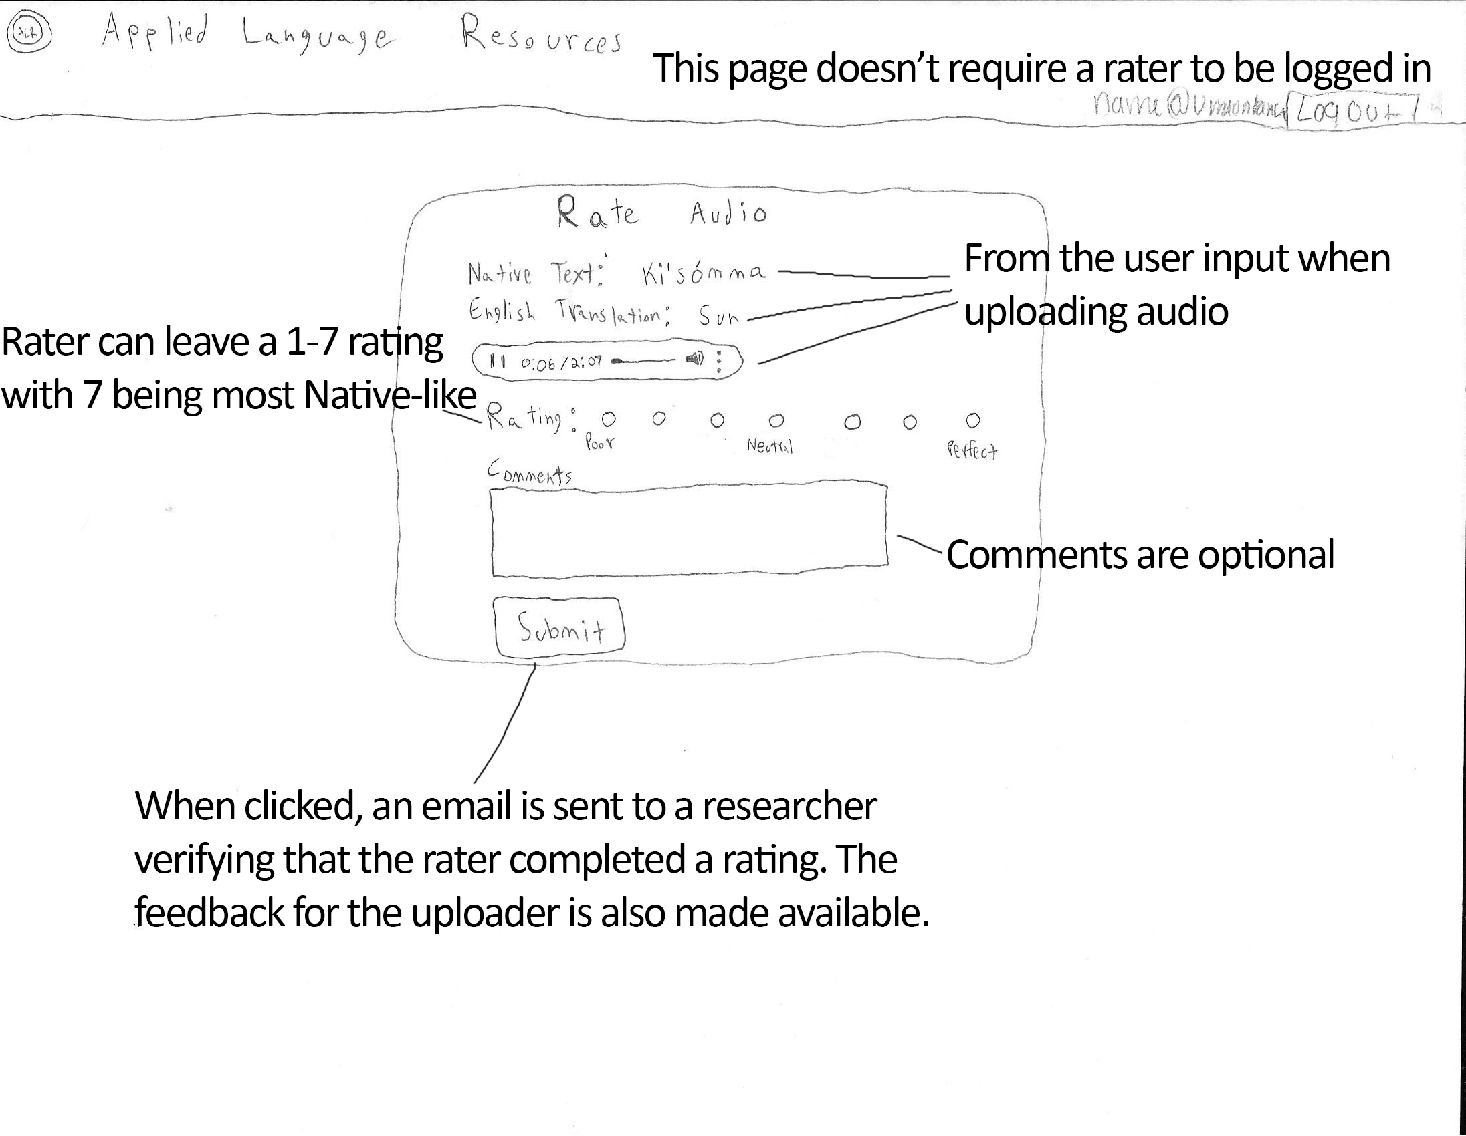
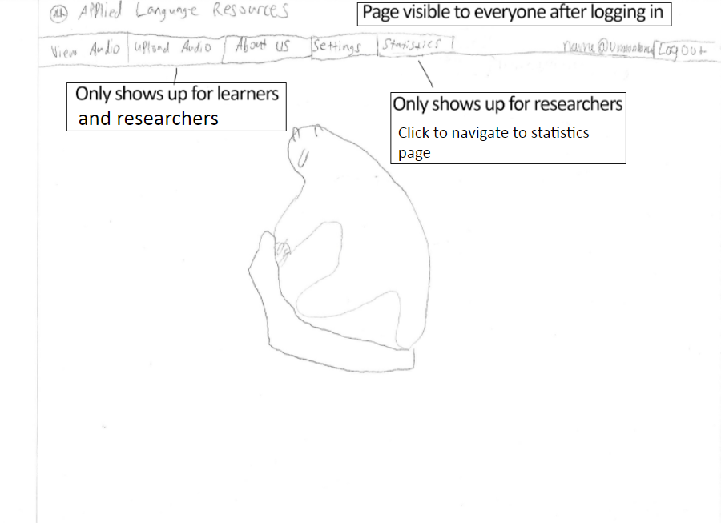
Design
Low-Fidelity Prototypes
Cheaper to create than final product
Identify conflicts early
Storyboards
Early design prototypes
Notes:
Linda
Early on in our design phase we created prototypes as a guideline for our HTML/CSS implementation. These prototypes gave us insight into the interaction between the database and the front-end and gave us valuable insight into what needed to change in the back-end. In the end, the look of the website ended up looking very similar to these prototypes.

Slide 8
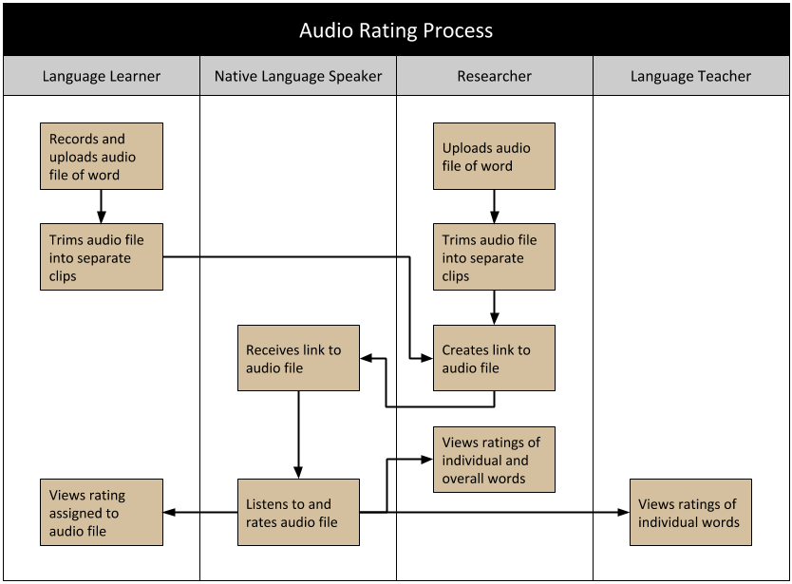
Design
System Modeling
Swimlane
The swimlane diagram represented the process of
uploading and rating an audio file. Which is a vital part
of our project.
Data Flow Diagram
This diagram represents how data flows through our entire system. This was helpful to our understanding of the data.
Entity Relationship Diagram
This diagram was chosen to help represent our system because data storage is heavily utilized
Notes:
Linda

Slide 9
Implementation
The Technology Stack
HTML/CSS
Javascript
Django (Server)
SQLite (Database)
Technology Thoughts and Challenges
Django ease of use
Dynamic HTML/Javascript
No SQL queries needed
SQLite difficult to maintain remotely
Notes:
David

Slide 10
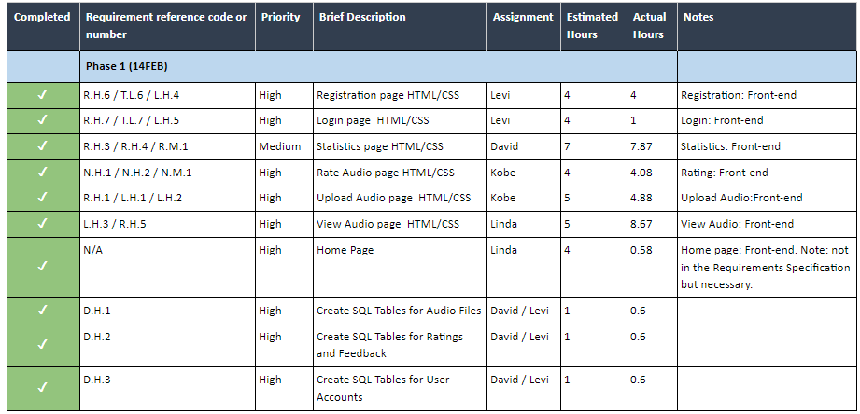
Implementation Plan
Development Phases
Front-end work
Back-end MVP
Additional Back-end
User Testing
Notes:
David This document laid out our implementation in 4 different phases: (1) HTML/CSS, (2) back-end changes, (3) touch-ups to the front-end and back-end, and (4) user testing. It helped us keep track of what priority tasks needed to be accomplished first as well as who is working on what task to avoid conflicts. We also tracked our estimated hours and actual hours per task.

Slide 11
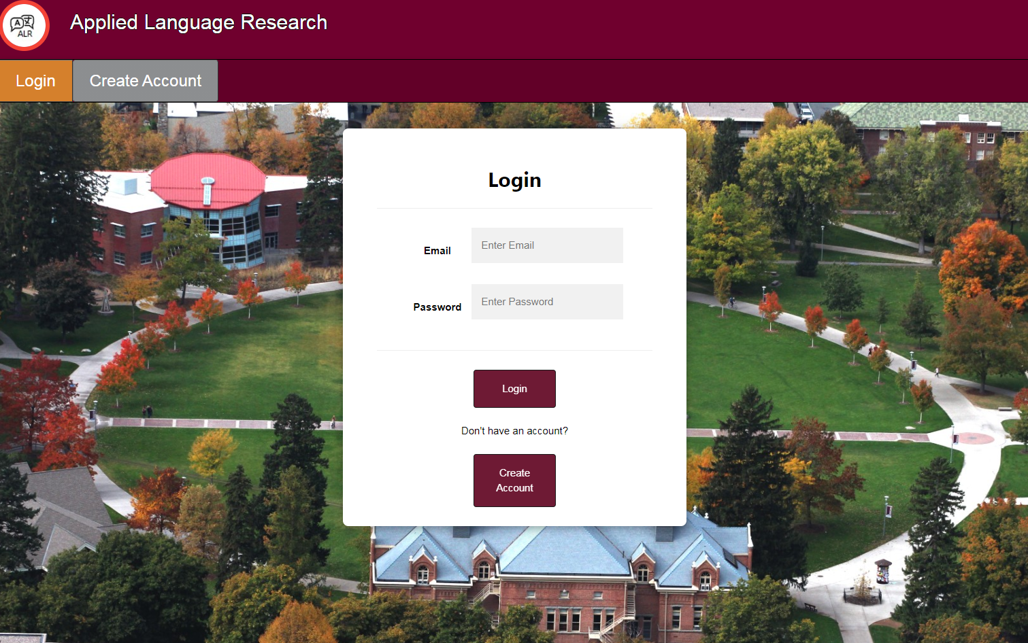
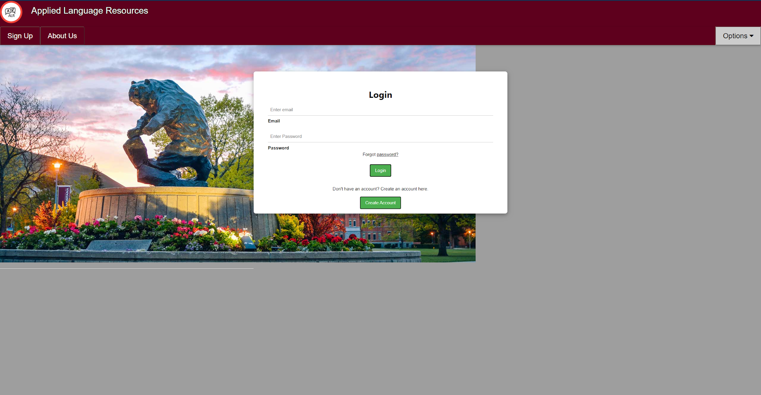
Login Page
Before
After
Notes:
David The login page before had some scaling issues that we fixed.

Slide 12
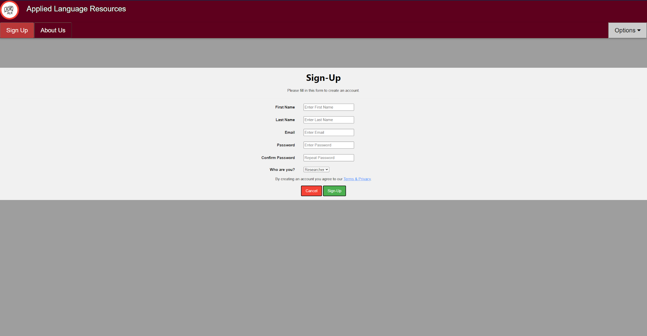
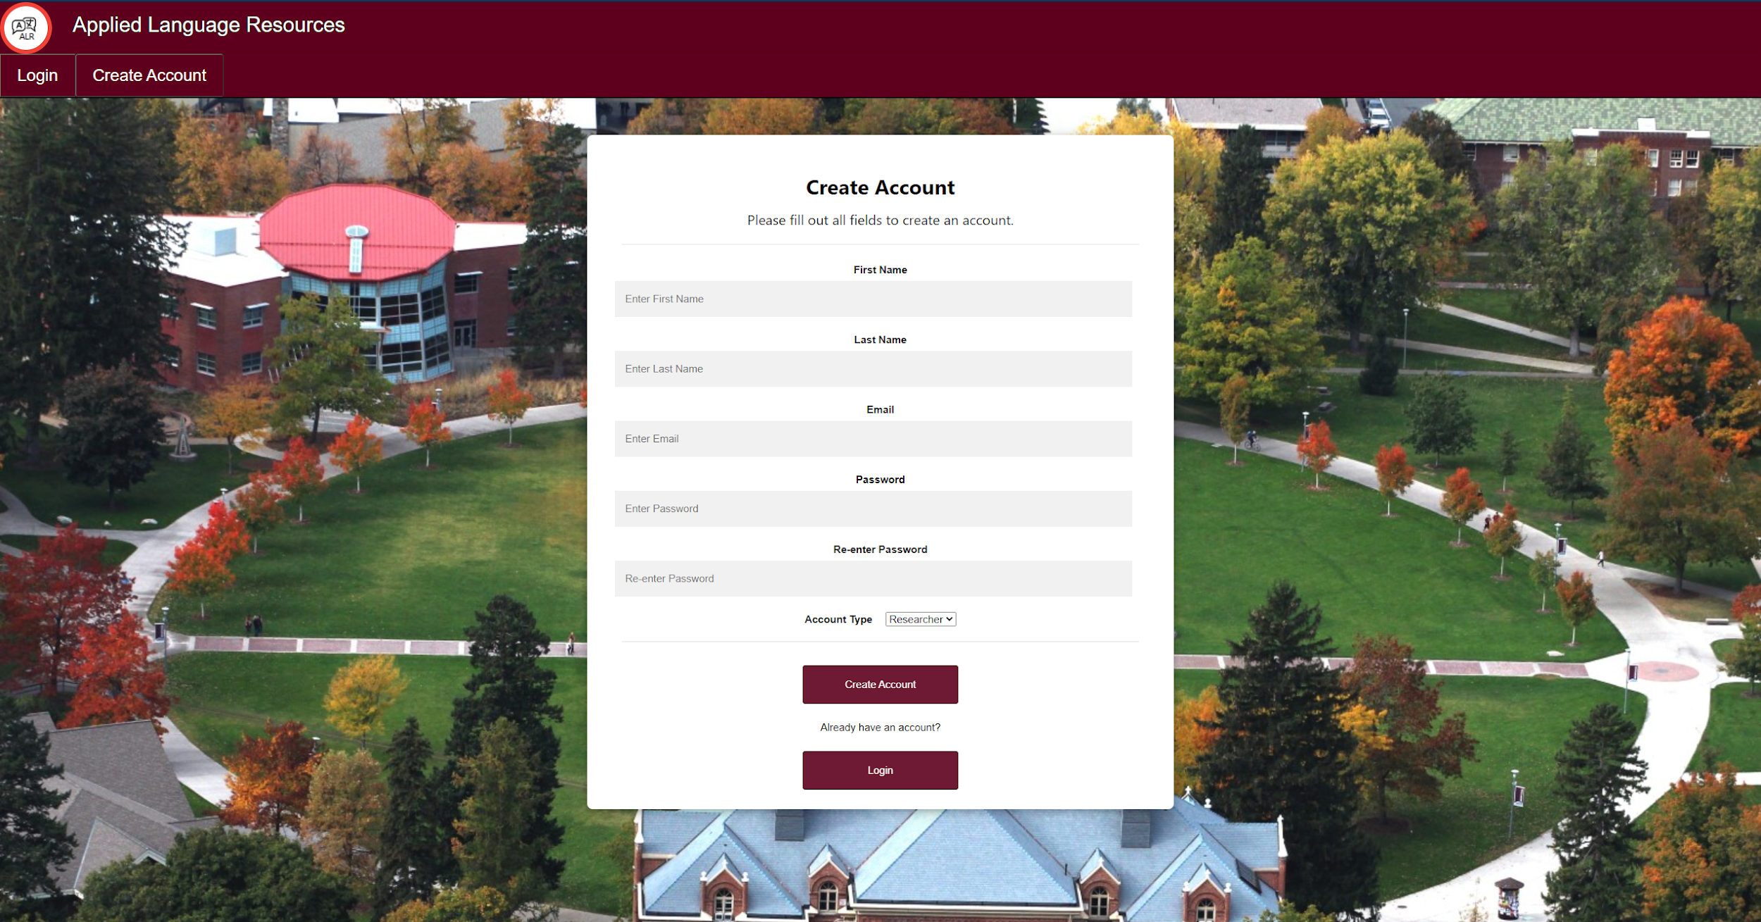
Registration Page
Before
After
Notes:
David

Slide 13
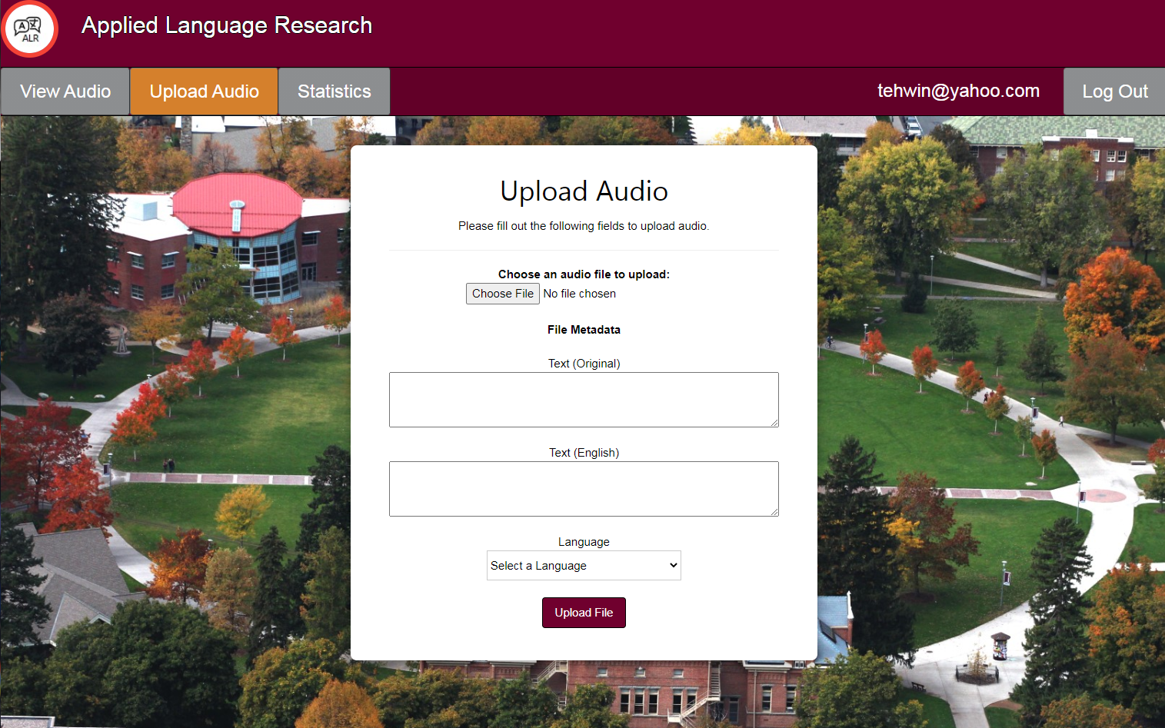
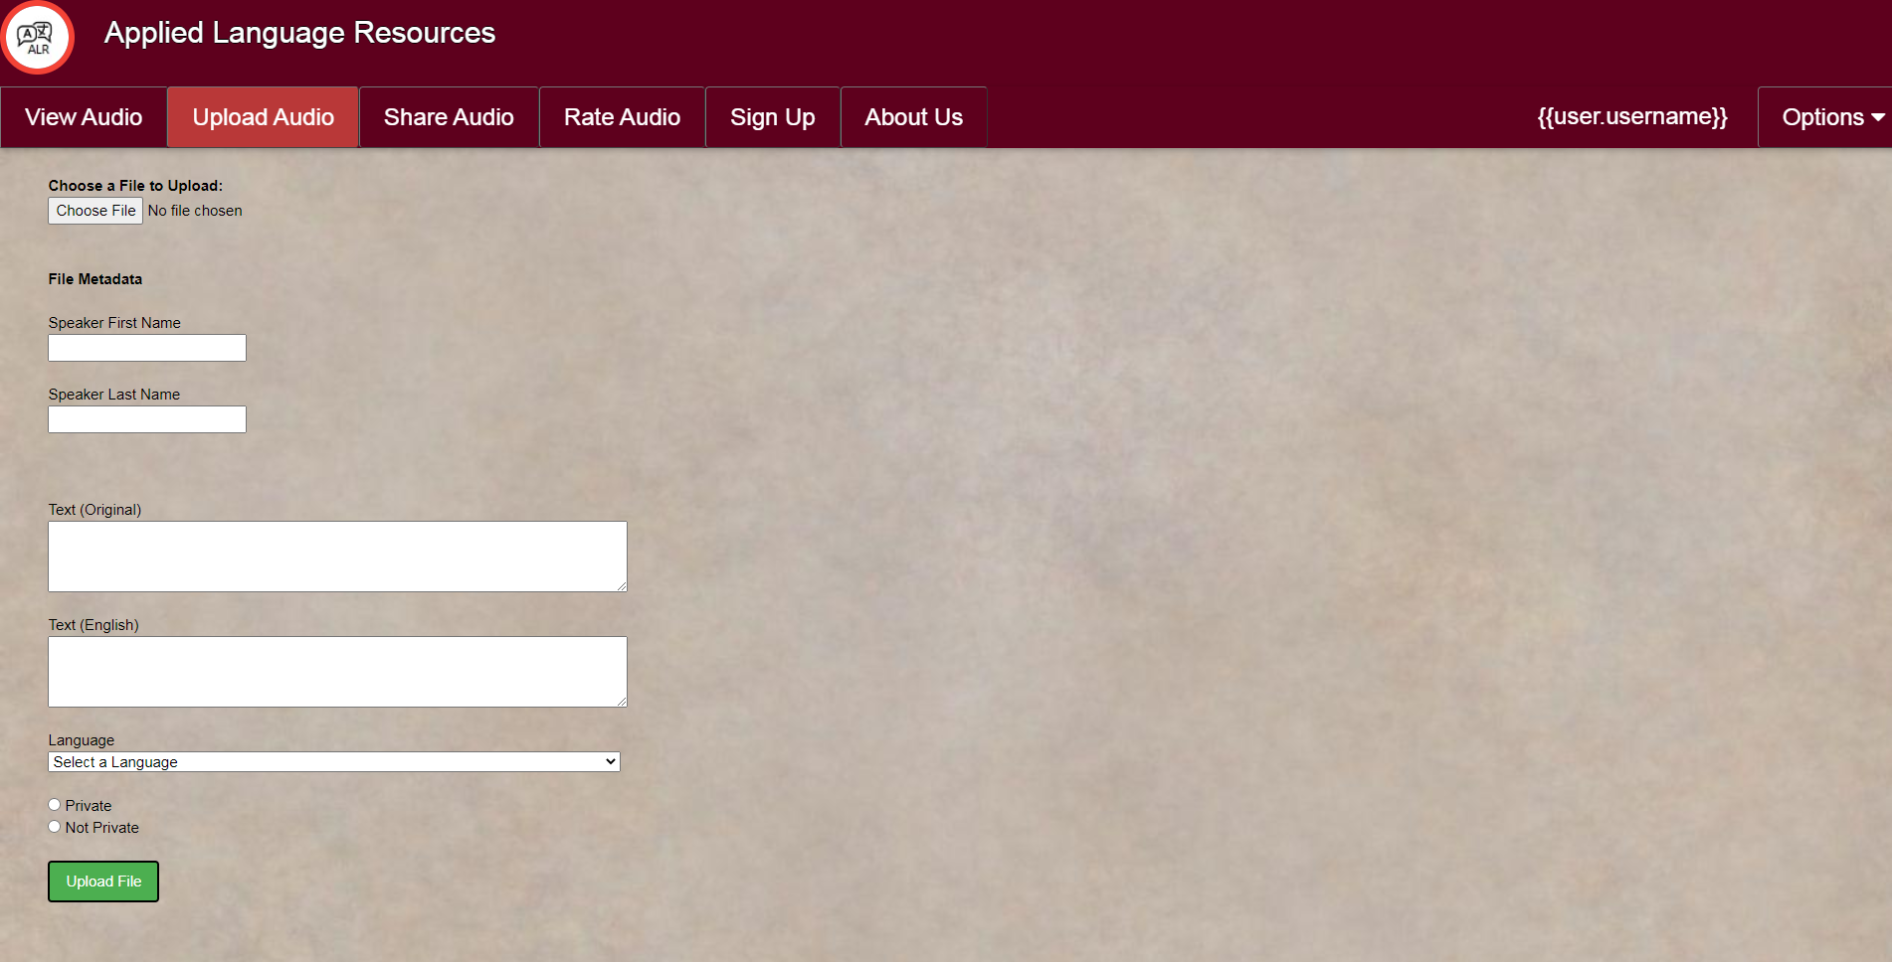
Upload Audio Page
Before
After
Notes:
David The upload audio page had an odd parchment paper background originally. We decided to recreate it into the box design that we commonly used on the website.

Slide 14
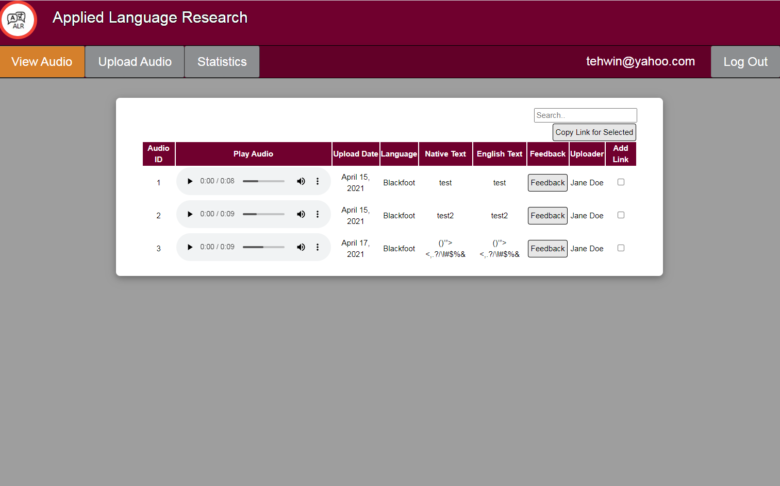
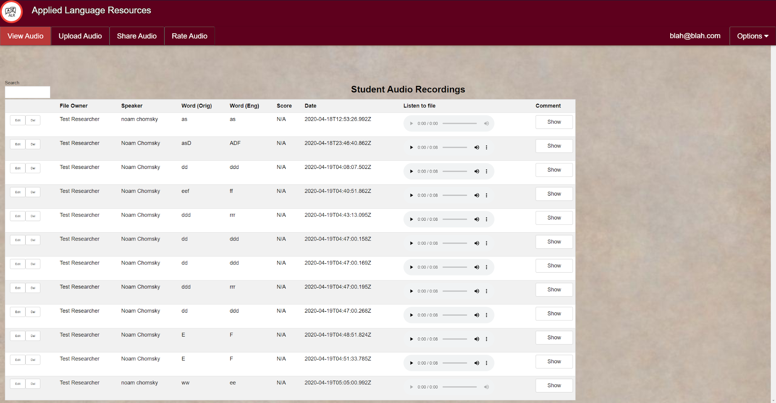
View Audio Page
Before
After
Notes:
David Got rid of parchment paper. Went for box design again.

Slide 15
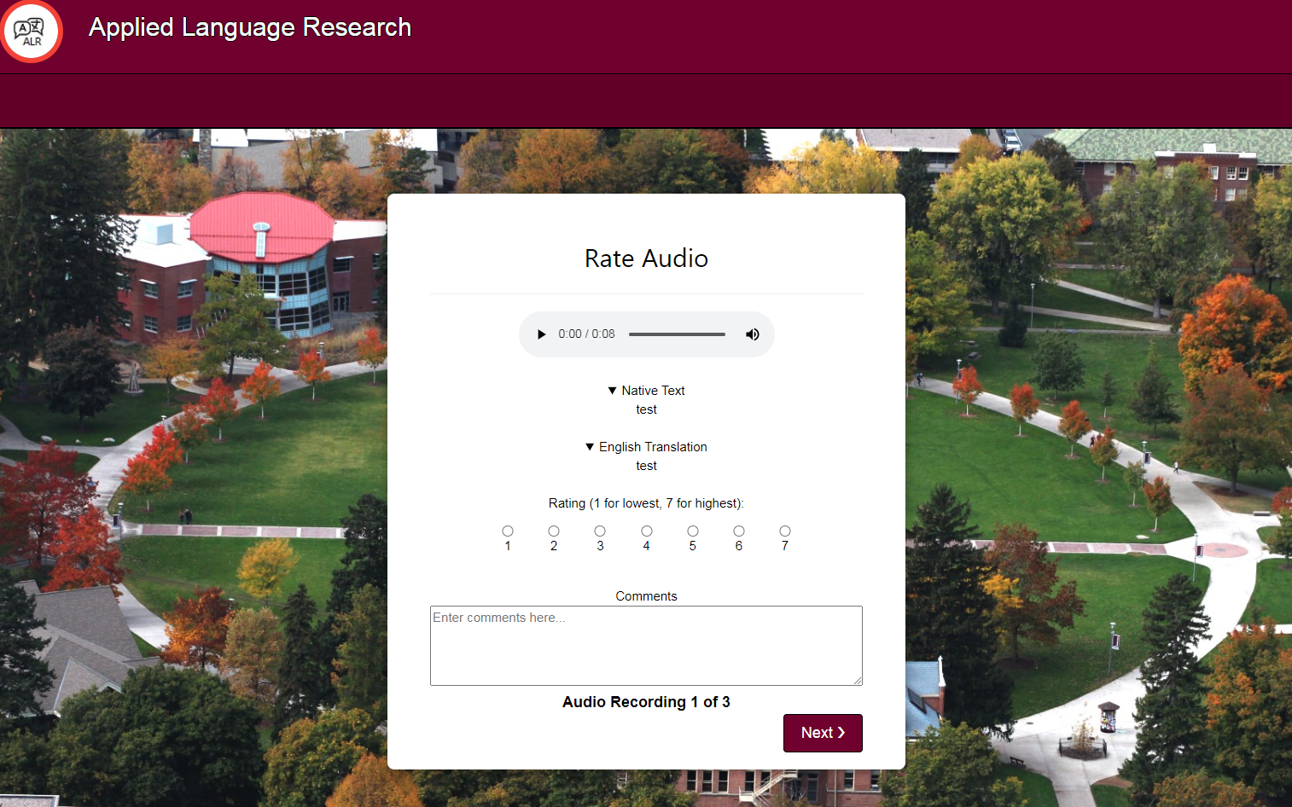
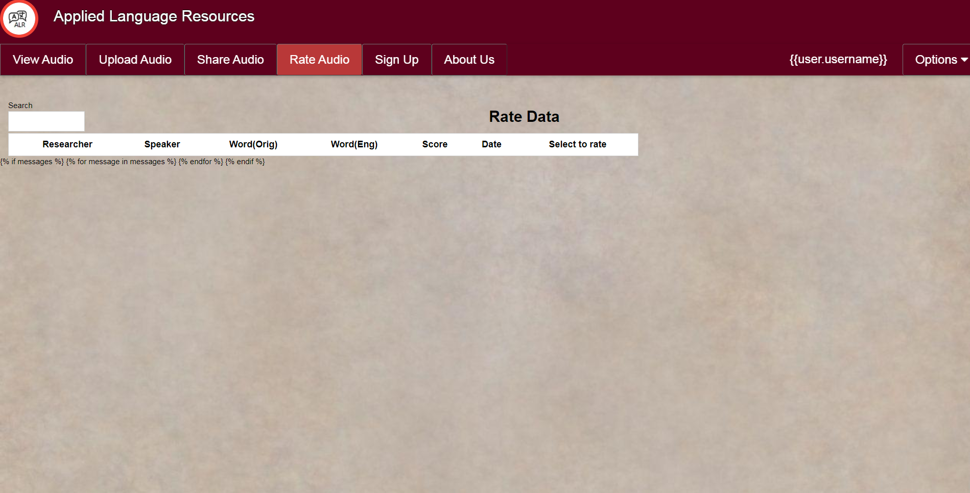
Rate Audio Page
Before
After
Notes:
David Complete re-design. Rating audio now accessible through unique link to anyone, either logged in or logged out. Functionality didn’t exist previously.

Slide 16
Roadblocks
Update work from previous team
Getting proper server permissions
Learning Django development
Changing requirements to focus on multiple ratings and feedback
Notes:
Kobe

Slide 17
Testing
Unit Testing
Functional Testing
Automated code testing
Catch bugs during development of individual functions
Ensure different functions of the website work as intended
Consider edge cases and invalid user inputs
Notes:
Kobe

Slide 18
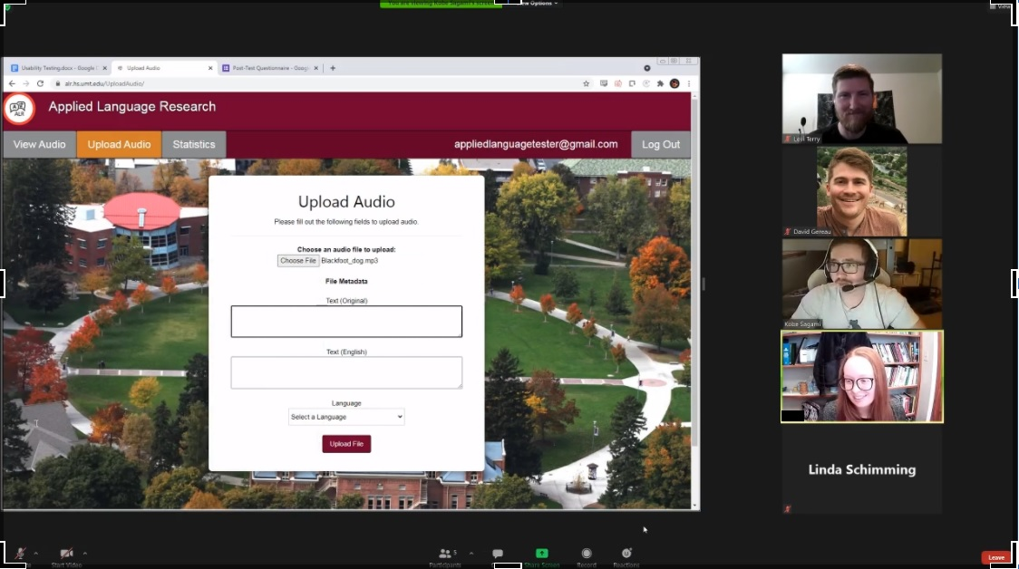
User Testing
Test website features
Praised by two language teachers
Helped highlight weak spots
Most deemed that site was easy-to-use
User Testing Session
Notes:
Kobe

Slide 19
Finished Product
Functionality Implemented
Way Ahead
Statistics
Administration
Functionality for teachers
Notes:
Kobe

Slide 20
Takeaways
David
Front-end development with a Team
Adding Django work to portfolio
Linda
New technical abilities
Working with a client
Levi
Great learning experience
Fun team to work with
Kobe
Learning how to code in a group setting
Web development experience

Slide 21
Questions?
Notes:
All

